Slide 1
Lecture - 15
Chapter G
MORPHOLOGICAL IMAGE PROCESSING

Slide 2
Preliminaries: Morphology
Morphology in image processing is a tool for extracting image components that are useful in the representation and description of region shape, such as boundaries and skeletons.
Furthermore, the morphological operations can be used for filtering, thinning and pruning.
The language of the Morphology comes from the set theory, where image objects can be represented by sets. For example, an image object containing black pixels can be considered a set of black pixels in 2D space of Z².

Slide 3




Preliminaries: Set Theory Fundamentals
Given that A is a set in Z²and a=(a₁,a₂), then
a is an element in A: a ∈ A
a is not an element in A:
a ∉ A
given sets A and B, A is said to be the subset of B:
A ⊆ B
The union of A and B is denoted by:
C = A B
The intersection of A and B is denoted by:
D = A B
Two sets are disjoint/mutually exclusive if A B =∅
A^{c} = {ω ω ∉ A} _{B}c
The complement of set A is the set of elements not contained in A,
The difference of two sets: A − B = {ω ω ∈ A,ω ∉ B} = A

Slide 4
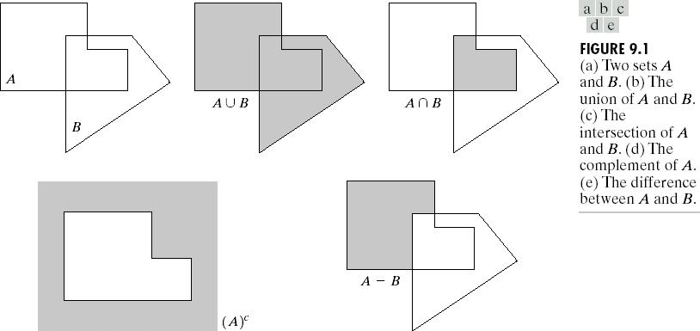
Preliminaries: Set Theory Fundamentals
Given 2 sets A and B

Slide 5
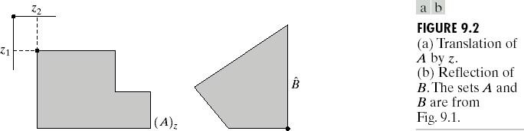
Preliminaries: Set Theory Fundamentals
The reflection of set B is defined by:
B^{ˆ} = {ω ω = −b, for b ∈ B}
The translation of set A by point z=(z₁,z₂) is defined by:
_{z} = {ω ω = a + z, for a ∈ A}
Translation of A by z
Reflection of B

Slide 6
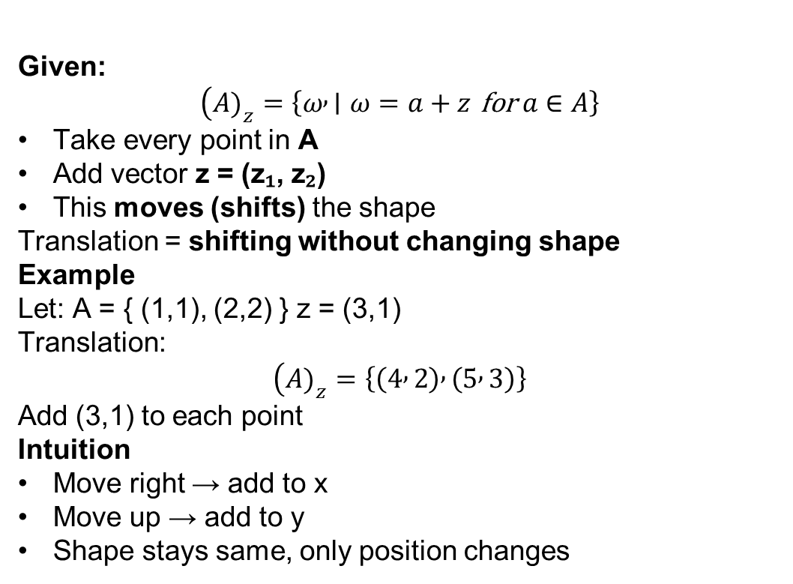
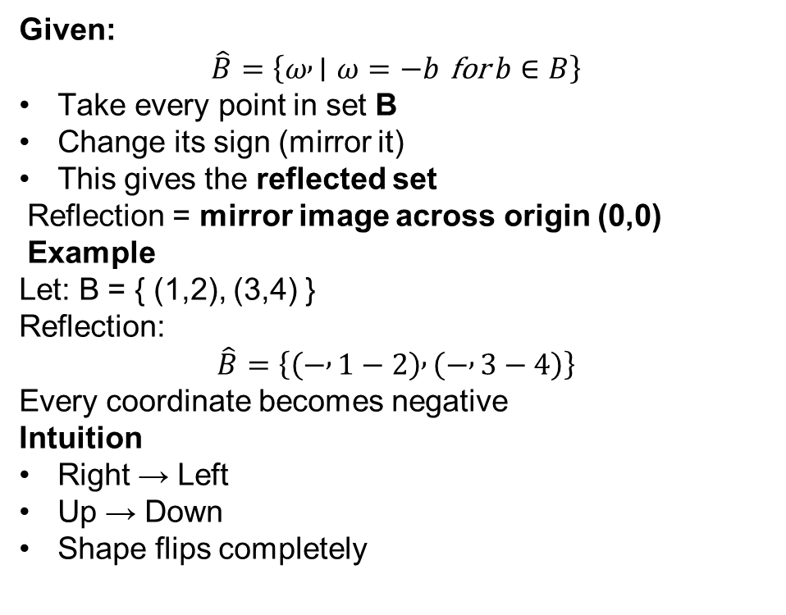
Reflection and Translation of a Set
Given:
$$\left(A{\left.)\right.}_{z}=\left\{ω , ∣ω=a+z \text{for} a∈A\right\}\right.$$
Take every point in A
Add vector z = (z₁, z₂)
This moves (shifts) the shape
Translation = shifting without changing shape Example
Let: A = { (1,1), (2,2) } z = (3,1)
Translation:
$$\left(A{\left.)\right.}_{z}=\left\{\left(4 , 2\right) , \left(5 , 3\right)\right\}\right.$$
Add (3,1) to each point
Intuition
Move right → add to x
Move up → add to y
Shape stays same, only position changes
Given:
$$\hat{B}=\left\{ω , ∣ω=−b \text{for} b∈B\right\}$$
Take every point in set B
Change its sign (mirror it)
This gives the reflected set
Reflection = mirror image across origin (0,0)
Example
Let: B = { (1,2), (3,4) }
Reflection:
$$\hat{B}=\left\{\left(− , 1−2\right) , \left(− , 3−4\right)\right\}$$
Every coordinate becomes negative
Intuition
Right → Left
Up → Down
Shape flips completely

Slide 7
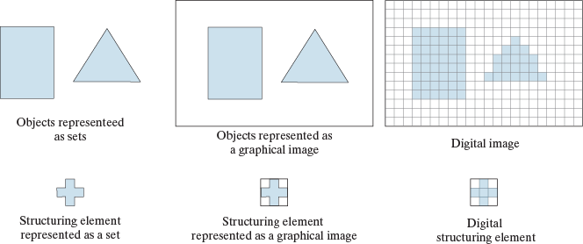
Preliminaries

Slide 8
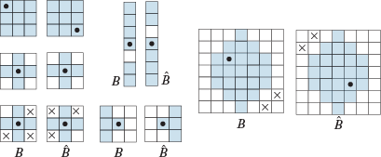
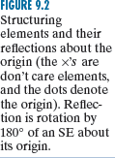
Preliminaries

Slide 9
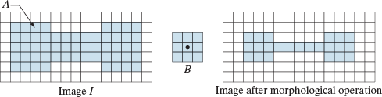
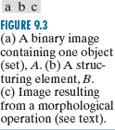
Preliminaries

Slide 10

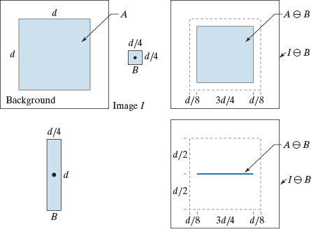
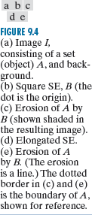
Erosion
A B = {z (B)_{z} ⊆ A}
The erosion of A by structuring element B is the set of all points z, such that B, translated by z, is
contained in A.
Erosion: Given A and B sets in Z², the erosion of A by structuring element B, is defined by:

Slide 11
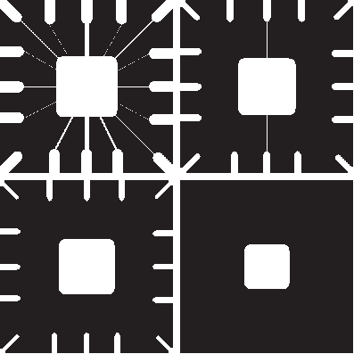
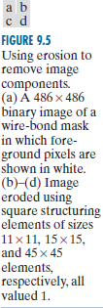
Erosion

Slide 12


Dilation
Dilation: Given A and B sets in Z², the dilation of A by structuring element B,
is defined by:
A ⊕ B ={z (B^{ˆ})_{z} A ≠ ∅}
The dilation of A and B is a set of all displacements, z , such that B and A
overlap by at least one element. The dilation can also be defined by:
A ⊕ B = {z ⎡⎣(B^{ˆ})_{z} A⎤⎦ ⊆ A}

Slide 13
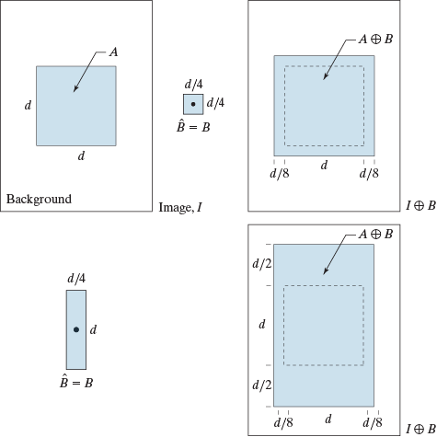
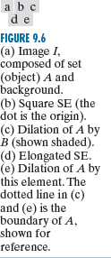
Dilation

Slide 14
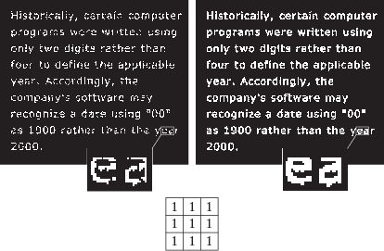
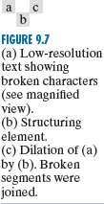
Dilation

Slide 15

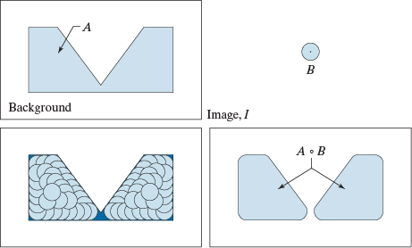
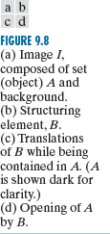
Opening
The process of erosion followed by dilation is called opening. It has the effect of eliminating small and thin objects, breaking the objects at thin points and smoothing the boundaries/contours of the objects.
Given set A and the structuring element B. Opening of A by structuring element B is defined by:
A ∘ B = ( A ⊗ B) ⊕ B

Slide 16
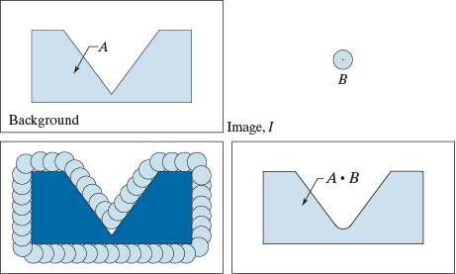
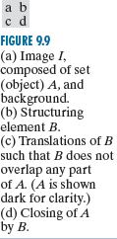
Closing
The process of dilation followed by erosion is called closing. It has the effect of filling small and thin holes, connecting nearby objects and smoothing the boundaries/contours of the objects.
Given set A and the structuring element B, closing of A by structuring element B is defined by:
A • B = ( A ⊕ B) ⊕ B

Slide 17
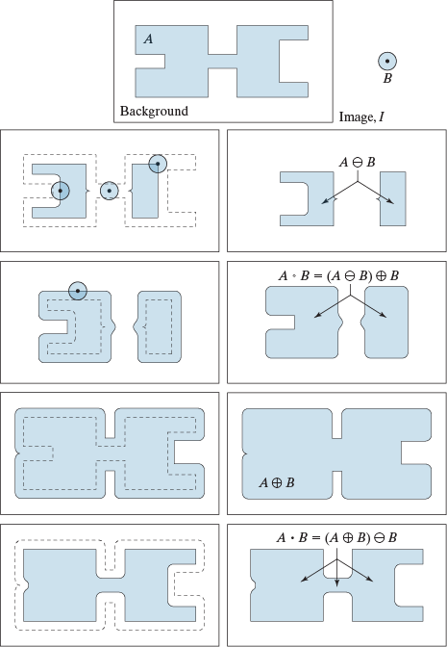
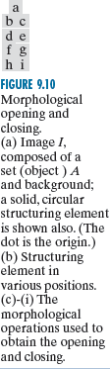
Opening Vs Closing

Slide 18
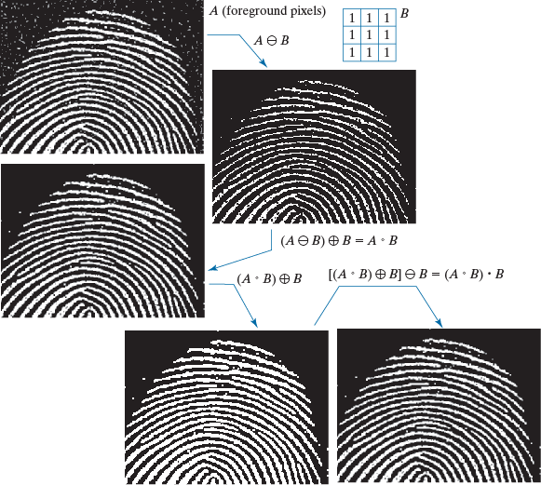
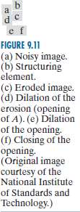
Opening s Closing

Slide 19
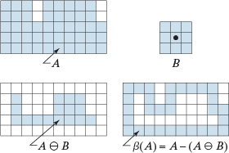
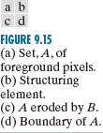
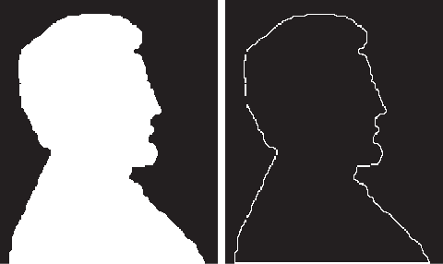
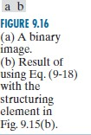
Applications of Morphological Image Processing
Boundary Extraction

Slide 20
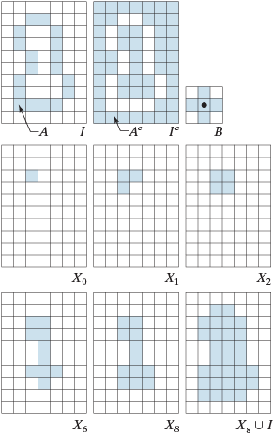
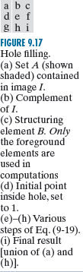
Applications of Morphological Image Processing
Hole Filling

Slide 21

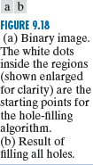
Applications of Morphological Image Processing
Hole Filling

Slide 22
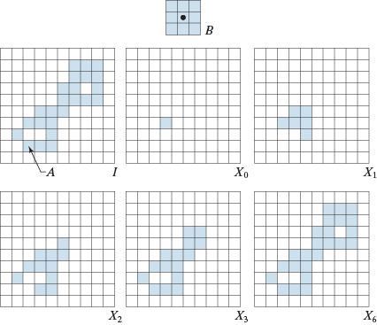
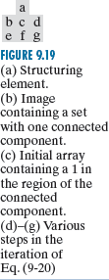
Applications of Morphological Image Processing
Connected Component Detection

Slide 23
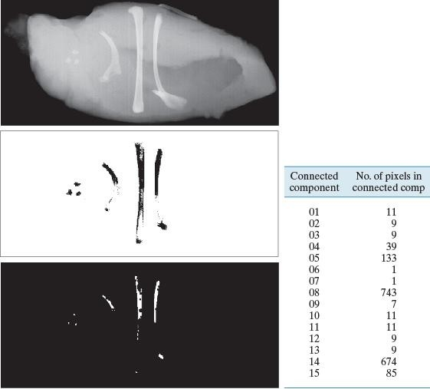
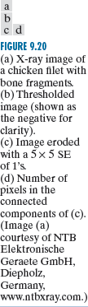
Applications of Morphological Image Processing
Connected Component Detection

Slide 24
Applications of Morphological Image Processing
Hole Filling

